Slide 1
The Simon Game
By: Leya, Salma, Yashna, Aliza

Slide 2
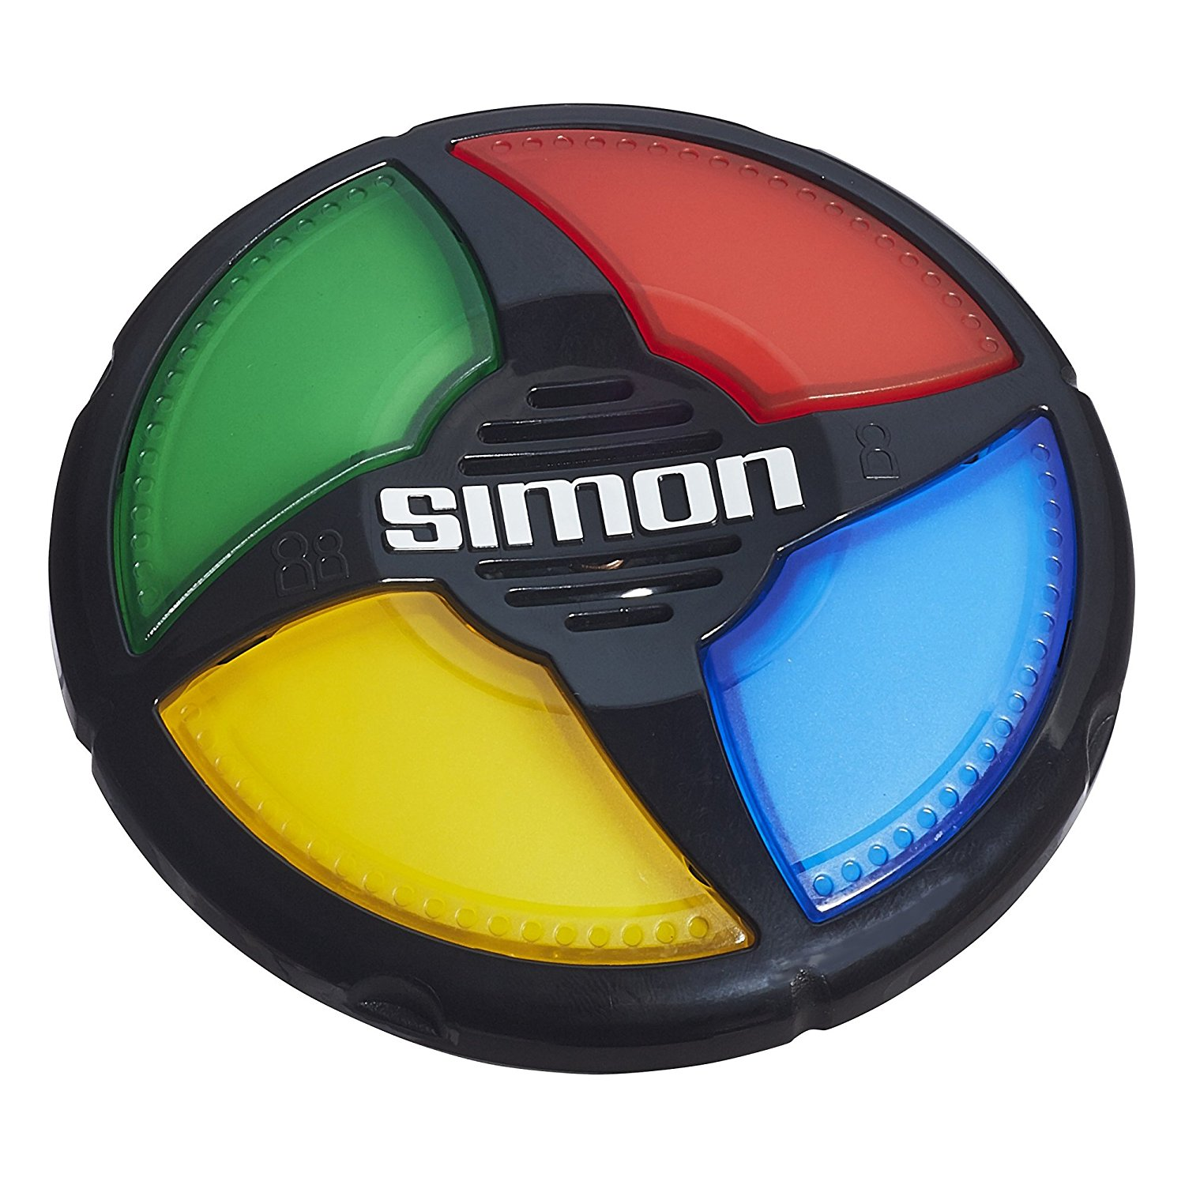
Simon History
Inventor Ralph Baer, the man who is best known for developing the first video game system was the inventor of Simon. Simon was based and inspired by an Atari arcade game called “Touch Me”.

Slide 3
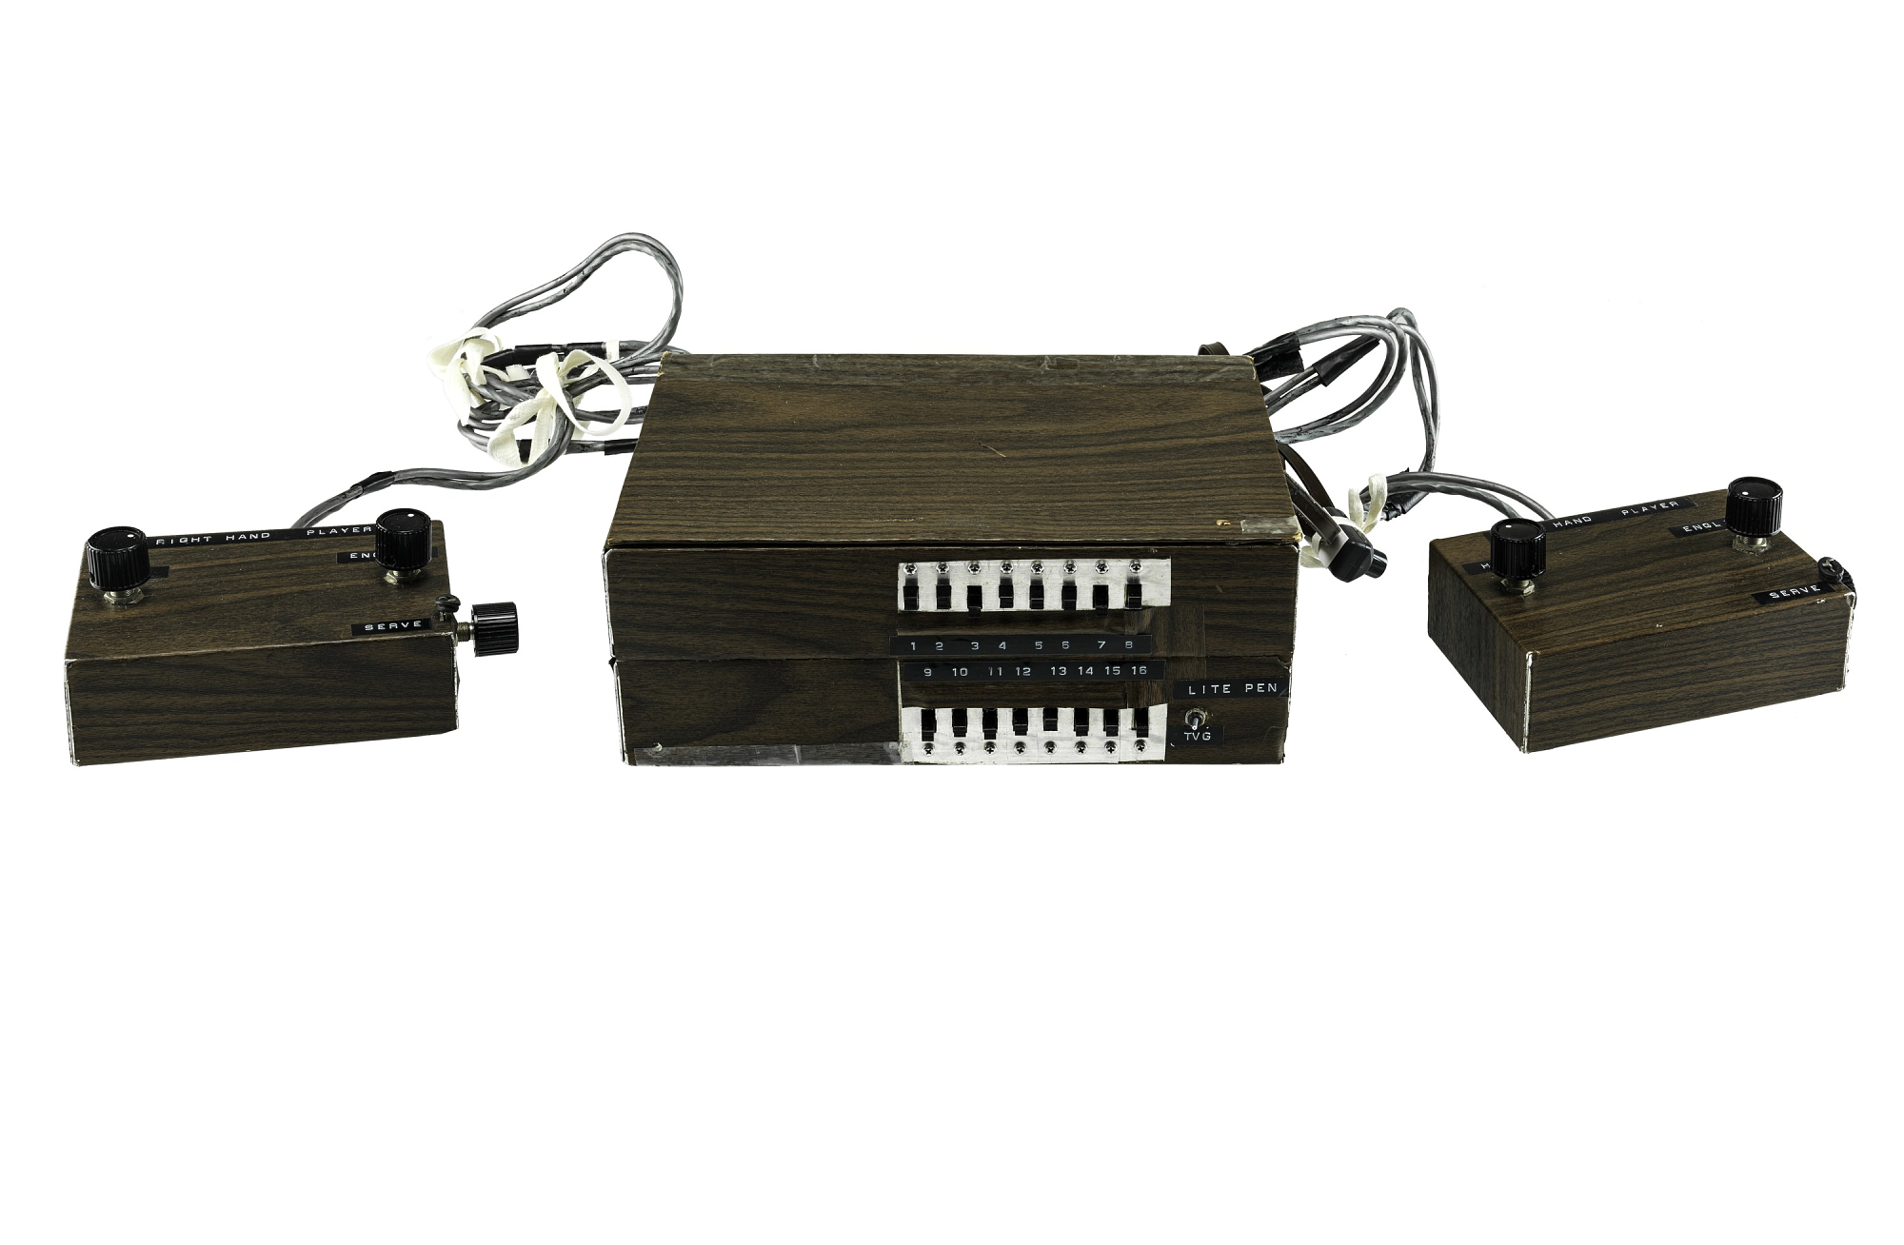
The First Gaming System
The first game system was called the “Brown Box”. The games the “Brown Box” had on it were ping pong, checkers, four different sports games, target shooting with the use of a light gun and a golf putting game, which required a special attachment. This was also created by Ralph Baer.

Slide 4
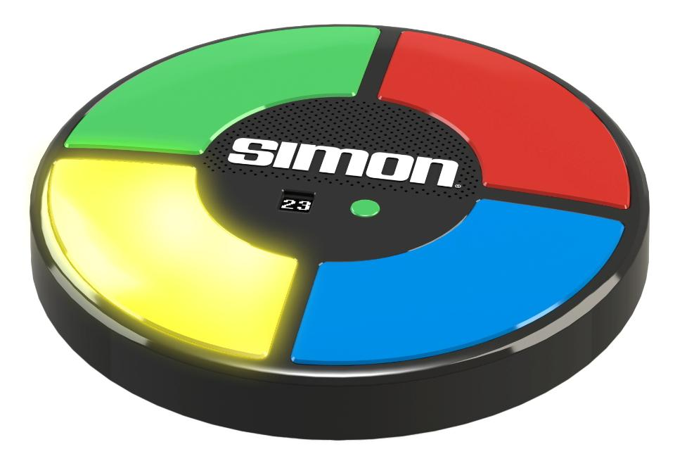
How It Works
The game outputs feedback to the player by making one of the four coloured blocks light up and make a sound.
The users input their data by pressing the correct coloured buttons in order to beat the level.

Slide 5
Simon Game Codes
The simon game uses simple codes, for example
136 GreenButton.addActionListener(new ActionListener() {
137
138 public void actionPerformed(ActionEvent e)
139 {
140 Pick = 3;
141 }

Slide 6
Explanation Of Game Codes
The game code system is pinpointing a color on the simon game that looks like 136 GreenButton This indicates that the coding system has chosen that color specifically. After the coding system pinpoints the color it adds an action listener. An action listener indicates that once the green button is clicked on something will happen like a domino effect. Also the action listener has one method along with it which is public void. Then after that is done the coding system has you choose however many colors depending on the level you are on. This looks like 140 Pick = 3; , The game code is indicating that you pick three colors that were repeated to you.

